Slide 1

CMR COLLEGE OF ENGINEERING & TECHNOLOGY
Kandlakoya, Medchal, Hyderabad - 501401
Department of Computer Science and Engineering
ANOMALY XPERT: A DEEP LEARNING APPROACH TO ANOMALY DETECTION
PRESENTED BY:
A.Abhinav - 20H51A0505
G.Praneeth - 20H51A0510
C.Harishwar - 20H51A05B9
Under esteemed guidance of
Ms.B.Gayathri
(Assistant Professor)

Slide 2
Outline
Abstract
Introduction
Literature survey
Existing system
- Problems in existing system
Research Objective of Presentation
Problem Definition
Research work
- Proposed system architecture
- Methods
- Comparison of Proposed system with an existing system
Performance Measure
Results
Conclusion
Future Work
References
Notes:
2

Slide 3
Abstract
Notes:
3

Slide 4
ABSTRACT
This project introduces a deep learning-based system for automated detection of robbery and suspicious activities in CCTV footage. Utilizing convolutional neural networks (CNNs) for object detection and recurrent neural networks (RNNs) for temporal analysis, the system identifies anomalous behaviors indicative of criminal activities. By analyzing each frame, the system accurately timestamps instances of robbery or suspicious behavior throughout the video.
Integration of advanced deep learning techniques, such as feature extraction and transfer learning, enhances the system's efficiency and accuracy. The system generates alerts and timestamps, enabling swift review and retrieval of relevant footage, thereby enhancing security monitoring and response capabilities.
Overall, this project contributes to the development of more effective surveillance systems for improved safety and security.

Slide 5
INTRODUCTION
Notes:
5

Slide 6

Introduction
Identifying abnormal activity is a laborious job, and this has led to the advancement in the domain of deep learning for surveillance which assured performance gain.
Detecting real-world problems such as accidents, burglary, explosion, fighting, robbery and other critical events is crucial.
Notes:
6

Slide 7
Literature Survey
Notes:
7

Slide 8
Existing system
S.No | Authors and Journal Name | Problem Statement | Name of the Proposed solution/Method | Solution | Remarks
1 | Jianwei & Chenetal | Anomaly Detection | OptiDetect | Track object movement, teach the camera what's normal. | Fine-tuning details like camera settings can be quite challenging.
2 | U. Shankar&V. Paxson | Anomaly Detection | Vid3D Guardian | Use 3D CNNs to analyze video sequences, detecting unusual patterns. | Training 3D CNNs demands significant computing power and abundant data.
3 | T. Ptacek & T. Newsham | Anomaly Detection | EnsembleWatch | Blend autoencoders and GANs to spot unusual frames effectively. | Balancing ensemble model elements can be complex, requiring careful design.
Notes:
8

Slide 9
Research Objective
Notes:
9

Slide 10
Research objective
The main objective of the project is to enhance this use age of deep learning in current situation.
There are many issues like time consuming process and some human error which can be solved by this process.
The proposed solutions saves the time which a human spend on finding a problem is CCTV footages.
We created a model which is trained with the abnormal activities such as thefts and some crimes and the testing model has a created its own memory.
The model identify the solution for the problem and it saves the big storages to be saved and it also help to find the problem easily so that the human power need not used which saves lot of time.

Slide 11
Problem Definition
Notes:
11

Slide 12
Problem Definition
In the context of person identification, human facial features and behavioral patterns are pivotal, with visual information serving as a primary data source. This project aims to automate the detection of robbery and suspicious behavior in CCTV footage using deep learning techniques.
The goal is to develop a system that can accurately identify and timestamp instances of criminal activity throughout the video. By automating this process, the system will improve security monitoring efficiency and enable timely intervention measures. This addresses the challenge of manual review of vast amounts of surveillance data, enhancing overall safety and security measures.

Slide 13
Research Work
Notes:
13

Slide 14
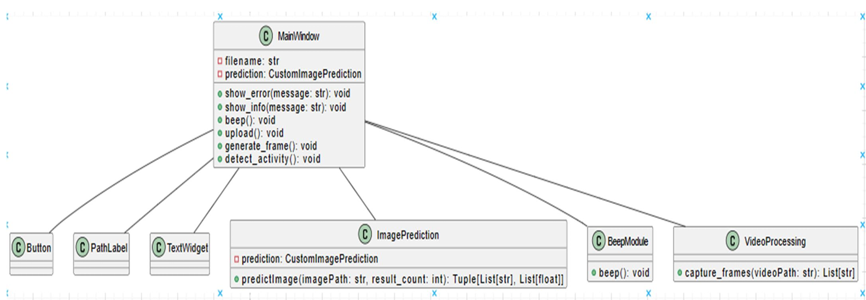
Proposed system architecture

Slide 15
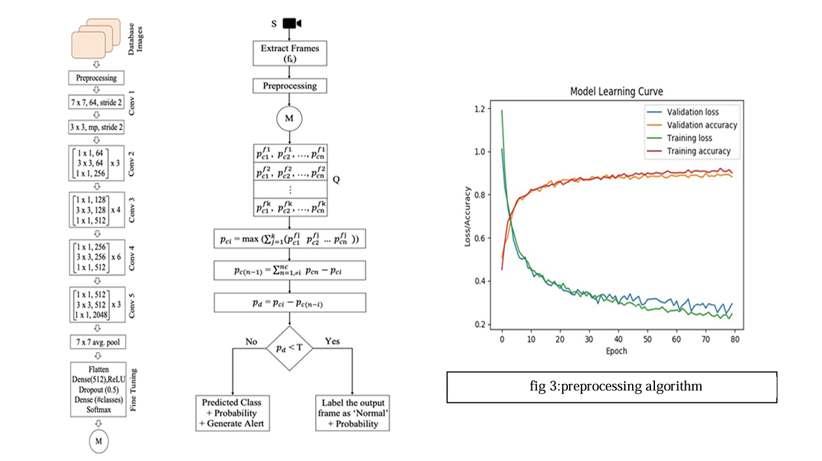
Proposed Methods

Slide 16
Performance Measure:
True Positive Rate (Sensitivity):
Also known as recall or true detection rate, it measures the proportion of actual anomalies that are correctly identified by the model.
False Positive Rate (Fall-Out):
Measures the proportion of normal instances incorrectly classified as anomalies.
Precision:
Also known as positive predictive value, it measures the accuracy of the model in detecting anomalies among the instances classified as anomalies.
F1 Score:
Harmonic mean of precision and recall, provides a balanced measure of model performance.

Slide 17
Result Analysis
High Efficiency: The developed deep learning-based system achieved a high level of accuracy in detecting instances of robbery and suspicious behavior in CCTV footage.
Efficient Timestamping: The system successfully timestamped instances of criminal activity throughout the video duration, enabling swift retrieval and review of relevant footage by security personnel.
Robustness and Efficiency: Integration of advanced deep learning techniques, such as CNNs and RNNs, contributed to the system's robustness and efficiency in anomaly detection, demonstrating its potential to significantly enhance security monitoring and response capabilities.

Slide 18
Conclusion
In present world, almost all the people are aware of the importance of CCTV footages, but most of the cases these footages are being used for the investigation purposes after a crime/incident have been happened. The proposed model has the benefit of stopping the crime before it happens. The real time CCTV footages are being tracked and analyzed. The result of the analysis is a command to the respective authority to take an action if in case the result indicates an untoward incident is going to happen.

Slide 19
Future work
Deep Learning Advancements:
Explore advanced deep learning architectures such as Transformers, Graph Neural Networks (GNNs), and attention mechanisms for anomaly detection in complex data types like graphs, sequences, and unstructured data.
Semi-Supervised and Self-Supervised Learning:
Investigate semi-supervised and self-supervised learning approaches to leverage unlabeled data effectively for anomaly detection, reducing the dependency on labeled anomaly samples.
Temporal Anomaly Detection:
Develop techniques for detecting anomalies in temporal data with long-range dependencies and evolving patterns, such as incorporating memory-enhanced models like Long Short-Term Memory (LSTM) networks.
Online and Real-Time Anomaly Detection:
Enhance anomaly detection systems to operate in real-time or near real-time, enabling timely detection and response to emerging anomalies in streaming data environments.

Slide 20
References
P. Bhavya Divya, S. Shruti, R. Devika, B. Sreya Reddy, “Investigation of suspicious human activity in crowdsourced areas captured in surveillance cameras”, International Research Journal of Engineering and Technology(IRJET), December 2017.
Jatin Musale, Alisha Gaikwad, Liyakat Sheikh, Pournima Haghvane, Sneha Tadke, “Detection and tracking of suspicious movements in human behavior and objects with fire detection using Closed Circuit TV (CCTV) cameras”, Global Symposium Research in Applied Science & Engineering Technology (IJRASET), Volume 5 Issue XII, December 2017.
U. M. Karthik, C. G. Patil, “Recognition of suspicious activities in video surveillance systems”, Fourth Global Symposium on Computing, Communication, Control and Automation (ICCUBEA), 2018.
https://ieeexplore.ieee.org/document/8791159
https://arxiv.org/abs/2009.11732
https://arxiv.org/abs/1901.03407
https://www.researchgate.net/publication/329869543_The_Aedes_aegypti_IMD_pathway_is_a_critical_component_of_the_mosquito_antifungal_immune_response

Slide 21
Thank You!

